Slide 1
Create a HUD
Task description & goal
Evidence
I will create a very basic overlay that the player uses to interact with different objects in the game. I have to add a way to click on objects in game and have to make sure that overlapping clickables are handled correctly
Results, feedback, your interpretations and learning
Clicking objects
The first thing I added was the functionality to click on things in the scene that support clicking logically named, clickable. This is done by ray tracing. I simply reuse the code of block B for this.
The objects that want to be clickable will inherit from the Clickable interface. There are two virtual functions to overload. Hover and click. The hard part however was creating the ray that is generated.
Generating a ray
I take the mouse position and normalize the values over a range of -1:1. At first I multiplied the direction with the view matrix so that rotations and everything were applied but this didn’t work. So I changed the way to approach this problem.
Instead of transforming the ray to world space from some made up space, I just did the reverse. When I press on the screen, I have the coordinates in screen space. By using the inverse of the projection matrix on this coordinate, I get the coordinates in clip space. This is nice because it should support different FOV values. I just make the z coordinate -1 because I’m looking in the camera’s view direction and the coordinates range from -1:1. Lastly, I multiply with the inverse of the view matrix to solve all the rotations. This results into the result below.
Ofcourse, with ray tracing, getting the closest intersection is very easy. I learned how to use matrices to easily create a ray from the mouse position to the 3D world.
Notes:
Summarize details about this activity you have performed this week in pursuit of your goals for the block. Describe what you did and why, the results you had, feedback received and related learning insights. Summarise what the next steps for this activity is (if any). Focus more on the task(s) you performed, than the thing(s) you created. Think about the decisions you made, and how you arrived at the solutions you did.
You can reference ILOs by number here if you feel that a particular area was really demonstrated.
Add any pictures, video and links to supporting evidence here. Add more slides for visuals if needed.
IMPORTANT: Keep this up-to-date as much as possible. Remember to do this every week.

Slide 2
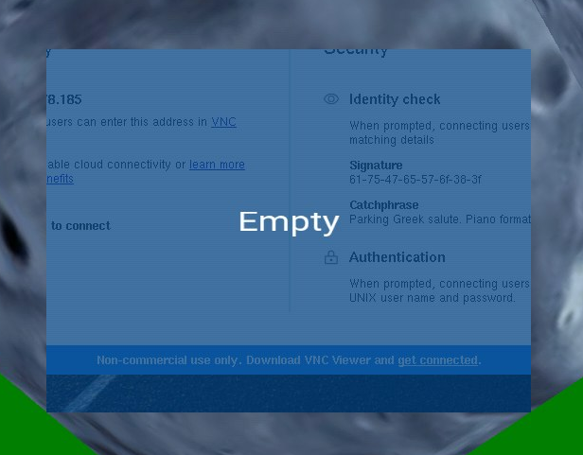
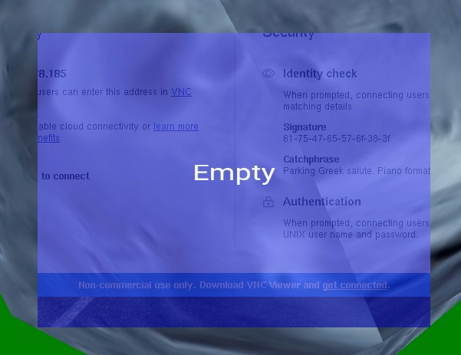
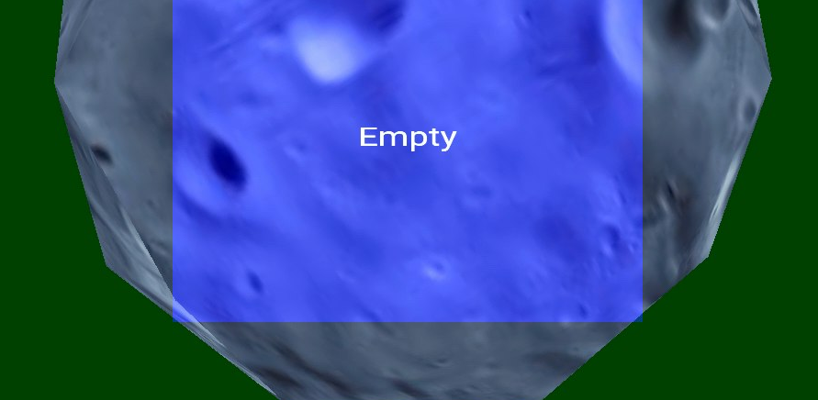
Create a HUD
Results, feedback, your interpretations and learning
Evidence
Opacity issues
Like most people, my background seems to be transparent. At first, this wasn’t really a pressing issue, but for my HUD, I wanted to use transparency. But as you can see in the pictures to the right. This didn’t work out as expected. Not only is the planet not rendered, the background is being shown. To solve this. I researched about depth testing and blending.
I’ve learned OpenGL uses a depth buffer for the depth test. We can specify the way the test is run with glDepthFunc. I use GL_LEQUAL because text is rendered at the same pos as UI elements, thus it passes the test because the depth is the same. I first drew the UI. Because of this, the planet depth test failed. Switching the order solved the problem.
I’ve also learned about how OpenGL does blending (if it is enabled). Blending basically specifies how OpenGL should deal with alpha values. The formula is very simple and we can specify the constants for the formula. The dest color is the color that is already in the buffer and the source color is the current color. We usually use the two parameters GL_SRC_ALPHA and GL_ONE_MINUS_SRC_ALPHA because a window with an alpha of 75 would 25% of the best color still shown.
Solving the transparency issue
With all this information, I came up with an solution to the transparency issue. I think that when OpenGL blends with the two functions written above, the final color becomes partially transparent. So to solve this, I changed the blendFunc for the transparent objects. The component for the destination color now is just 1. This means that the final color will not be an accurate transparent color because it merges the color behind it fully, but the final color does get tinted with the transparent color which results into the result on the right.
I’ve learned how OpenGL handles blending and depth tests. I’ve also learned how to modify how these operations are executed, making me able to solve the transparency issue.
In the left picture the planet fails the depth test because is is renderer after the UI element, In the right the order is reversed and the depth test passes
Blending tutorial
Depth testing tutorial
Notes:
Summarize details about this activity you have performed this week in pursuit of your goals for the block. Describe what you did and why, the results you had, feedback received and related learning insights. Summarise what the next steps for this activity is (if any). Focus more on the task(s) you performed, than the thing(s) you created. Think about the decisions you made, and how you arrived at the solutions you did.
You can reference ILOs by number here if you feel that a particular area was really demonstrated.
Add any pictures, video and links to supporting evidence here. Add more slides for visuals if needed.
IMPORTANT: Keep this up-to-date as much as possible. Remember to do this every week.

Slide 3
Create a HUD
Results, feedback, your interpretations and learning
Evidence
Hitbox for the HUD
Initially, I made this job way to difficult. I was implementing my old AABB code to add intersections for the UI boxes. But the UI is orthogonal and the ray is perspective. This means that I have to transform the ray back to screen coords and then transform it with an orthogonal projection.
This honestly seemed like way too much trouble and after reconsidering for a moment I realized that I’m actually dealing with 2D space. Thus, I can easily just take the mouse position on the screen and check if it is inside the bounding box of the HUD. One huge intersection test became a simple if check.
In the future, I should try and simplify problems as much as possible. Instead of trying to shape the whole project to make things work, just extend things. Especially in this case, since the system that is responsible for the clickable objects is quite isolated from the rest of the program.
Next steps
I will build on this system. It suffices for what I want to do. The next step would be to make planets able to build ships.
Notes:
Summarize details about this activity you have performed this week in pursuit of your goals for the block. Describe what you did and why, the results you had, feedback received and related learning insights. Summarise what the next steps for this activity is (if any). Focus more on the task(s) you performed, than the thing(s) you created. Think about the decisions you made, and how you arrived at the solutions you did.
You can reference ILOs by number here if you feel that a particular area was really demonstrated.
Add any pictures, video and links to supporting evidence here. Add more slides for visuals if needed.
IMPORTANT: Keep this up-to-date as much as possible. Remember to do this every week.

Slide 4
Make Planets build Vessels
Task description & goal
Evidence
Planets should be able to build vessels. I have to make decisions on how the vessels are saved in memory and what they will do when created.
Results, feedback, your interpretations and learning
For this task, I will try to do it more in steps then all at once. The first thing that I want to do is be able to create a ship by just clicking the planet. By doing this, I have confirmed that ships can spawn accordingly.
Creating the design
The system needs to follow the following criterias:
Only one HUD can be selected at a time. I probably only have 2 HUDs: a planet shop HUD and a vessel command HUD.
The HUD needs some way to interact with the Planet (knowing credits, tech level).
The HUD must be able to create new things (shop must create vessel, access to drawable factory).
The HUD must have some way to put the information in the game memory so that the scene becomes the owner of the vessel or whatever data structure I have implemented at the moment.
The hardest part are those last 3. There is quite a bit of communication going on there. The first thing to note is that the Planet already is a clickable. HUD also inherits from clickable. We can’t make planet inherit from HUD because that would result into the diamond of death.
This means that it can only serve as composition. Which is alright, but I will have to change the base class interface for the subclass interface which is a violation of the SOLID principles (Dependency Inversion Principle to be exact). I think that it is justified this time though because in the game all planets are the same so there is no reason to make it a interface or keep it flexible. I will put my UML on the next SLIDE
Insert LINKS
Notes:
Summarize details about this activity you have performed this week in pursuit of your goals for the block. Describe what you did and why, the results you had, feedback received and related learning insights. Summarise what the next steps for this activity is (if any). Focus more on the task(s) you performed, than the thing(s) you created. Think about the decisions you made, and how you arrived at the solutions you did.
You can reference ILOs by number here if you feel that a particular area was really demonstrated.
Add any pictures, video and links to supporting evidence here. Add more slides for visuals if needed.
IMPORTANT: Keep this up-to-date as much as possible. Remember to do this every week.

Slide 5
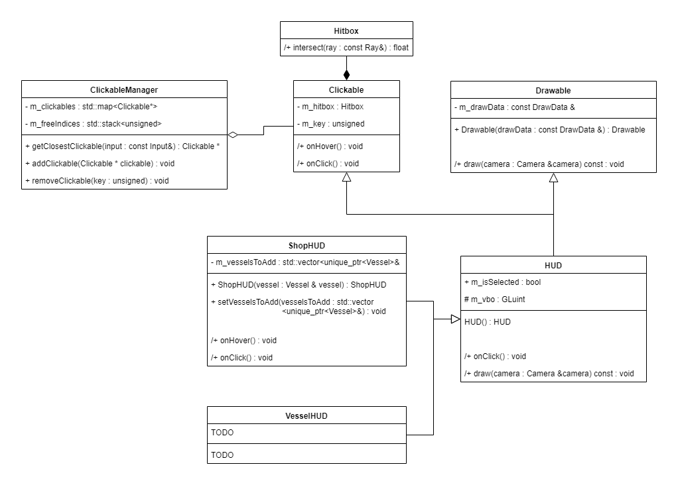
Make Planets build Vessels
Results, feedback, your interpretations and learning
Evidence
V1 and its flaws
This design satisfies all criterias noted in the previous slide. To elaborate: clickable is a base class for all things clickable. The clickable manager returns the closest clickable that it gets with the help of ray tracing. ClickableManager doesn’t manage the lifetime of the clickable objects, so the name is still up for debate, probably something like ClickableSelecter would make more sense.
Planet owns a ShopHUD object. When I click on a Planet. I will probably forward some calls in the Planet itself.
An important distinction to make is the difference between Clickable and HUD. As of right now, all things that can be clicked on in game are planets, vessels and HUDs. I may have to make ClickableManager only return the HUD because that is the thing that I’m interested in. A HUDManager may be useful.
To know when to draw the ShopHUD. I will add some code to the Planet that when clicked, it will set an isSelected variable. This variable will change by some HUDSelector class. This is because when I click on something that isn’t the HUD, the HUD should disappear
Insert Visuals
Insert LINKS
Notes:
Summarize details about this activity you have performed this week in pursuit of your goals for the block. Describe what you did and why, the results you had, feedback received and related learning insights. Summarise what the next steps for this activity is (if any). Focus more on the task(s) you performed, than the thing(s) you created. Think about the decisions you made, and how you arrived at the solutions you did.
You can reference ILOs by number here if you feel that a particular area was really demonstrated.
Add any pictures, video and links to supporting evidence here. Add more slides for visuals if needed.
IMPORTANT: Keep this up-to-date as much as possible. Remember to do this every week.

Slide 6
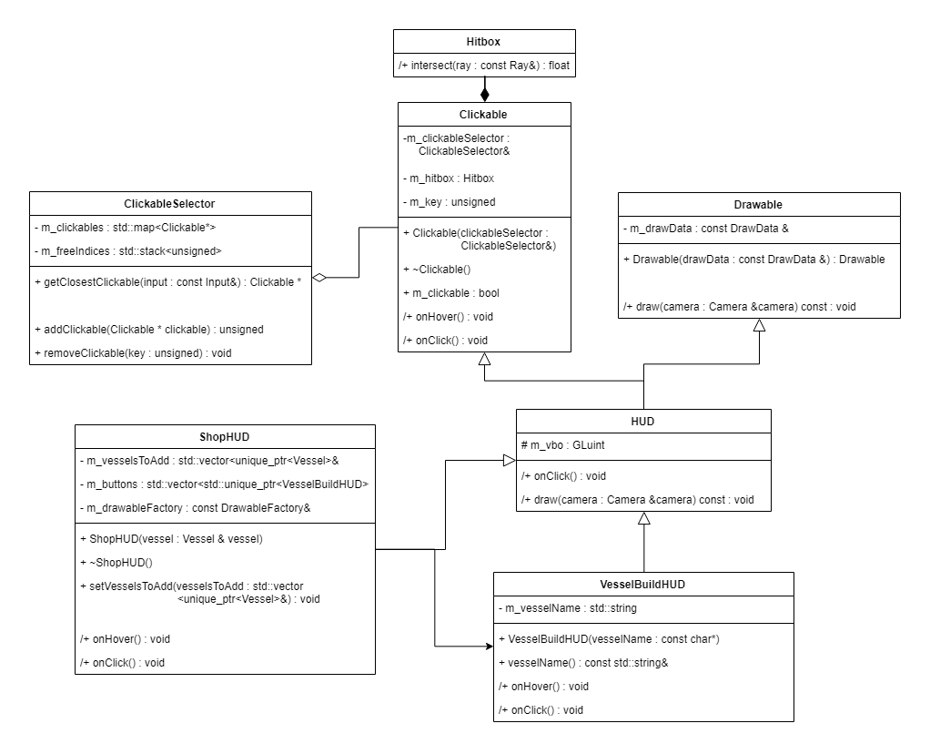
Make Planets build Vessels
Results, feedback, your interpretations and learning
Evidence
V2 discussion
I’ve decided to change the Clickable to include a variable which allows it to decide that it is clickable or not. I do this is an isolated system.
Every clickable also has an lastClicked variable. This is used for HUD elements to let them know if they still have to be displayed or not. This bloats the interface because many objects don’t need the variable, but again this is a specific system that doesn’t need additional flexibility. Only the ability to click on ships and planets.
When a planet is clicked, the ShopHUD and its VesselBuildHUD clickable state will become true. When the ShopHUD is unselected, they will become false again.
Right now, I’ll try and implement part of it. The first task is to make a button that builds a ship.
Insert Visuals
Insert LINKS
Notes:
Summarize details about this activity you have performed this week in pursuit of your goals for the block. Describe what you did and why, the results you had, feedback received and related learning insights. Summarise what the next steps for this activity is (if any). Focus more on the task(s) you performed, than the thing(s) you created. Think about the decisions you made, and how you arrived at the solutions you did.
You can reference ILOs by number here if you feel that a particular area was really demonstrated.
Add any pictures, video and links to supporting evidence here. Add more slides for visuals if needed.
IMPORTANT: Keep this up-to-date as much as possible. Remember to do this every week.

Slide 7
Make Planets build Vessels
Step by step process
Results, feedback, your interpretations and learning
I’ve always had trouble coming up with a HUD design, but I’ve created a quite functioning one. It’s quite inflexible, right now every planet has its own HUD object which I just access and select as the HUD to render. I am also still struggling with alpha values but learned about OpenGL Blending and depth test. One problem with the transparent HUD is that it is drawn by the planet. Because of this, objects that are drawn after the HUD fail the depth test and thus are not rendered.
Next steps
Another step is done in the list of deadlines. There are quite a few to go but almost all fundamental systems are in place (text renderer, UI system, Scene manager, factory). Building on this should be easy. The upcoming days will be focussed more on actual gameplay elements. But I first will add support for SOIs because the teachers wanted to see that.
Notes:
Summarize details about this activity you have performed this week in pursuit of your goals for the block. Describe what you did and why, the results you had, feedback received and related learning insights. Summarise what the next steps for this activity is (if any). Focus more on the task(s) you performed, than the thing(s) you created. Think about the decisions you made, and how you arrived at the solutions you did.
You can reference ILOs by number here if you feel that a particular area was really demonstrated.
Add any pictures, video and links to supporting evidence here. Add more slides for visuals if needed.
IMPORTANT: Keep this up-to-date as much as possible. Remember to do this every week.

